Slide 1
BUS7450 Strategic Marketing Management
Week 6
Dr. Jenne Meyer

Slide 2
BUS7500
Article reviews

Slide 3
11 Competitive Dynamics

Slide 4
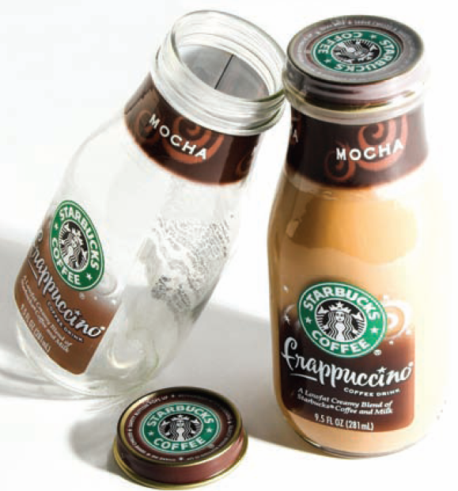
Expanding the Total Market
Notes:
When the total market expands, the dominant firm usually gains the most. If Heinz can convince more people to use ketchup, or to use ketchup with more meals, or to use more ketchup on each occasion, the firm will benefit considerably because it already sells almost two-thirds of the country’s ketchup. In general, the market leader should look for new customers or more usage from existing customers. Every product class has the potential to attract buyers who are unaware of the product or are resisting it because of price or lack of certain features. In addition to sales through our company-operated retail stores, Starbucks sells whole bean coffees through a specialty sales group and supermarkets. Additionally, Starbucks produces and sells bottled Frappuccino® coffee drinks and a line of premium ice creams through its joint venture partnerships and offers a line of innovative premium teas produced by its wholly owned subsidiary, Tazo Tea Company. Marketers can try to increase the amount, level, or frequency of consumption. They can sometimes boost the amount through packaging or product redesign. Larger package sizes increase the amount of product consumers use at one time. Consumers use more of impulse products such as soft drinks and snacks when the product is made more available.

Slide 5
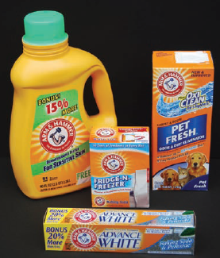
New Ways to Use a Brand
Notes:
Increasing frequency of consumption, on the other hand, requires either (1) identifying additional opportunities to use the brand in the same basic way or (2) identifying completely new and different ways to use the brand. After discovering that some consumers used Arm & Hammer baking soda as a refrigerator deodorant, the company launched a heavy promotion campaign focusing on this use and succeeded in getting half the homes in the United States to adopt it. Next, the company expanded the brand into a variety of new product categories such as toothpaste, antiperspirant, and laundry detergent.

Slide 6
Protecting Market Share
Responsive anticipation
Creative anticipation
Notes:
In satisfying customer needs, we can draw a distinction between responsive marketing, anticipative marketing, and creative marketing. A responsive marketer finds a stated need and fills it. An anticipative marketer looks ahead to needs customers may have in the near future. A creative marketer discovers solutions customers did not ask for but to which they enthusiastically respond. A company needs two proactive skills: (1) responsive anticipation to see the writing on the wall, as when IBM changed from a hardware producer to a service business and (2) creative anticipation to devise innovative solutions, as when PepsiCo introduced H2OH! (a soft drink–bottled water hybrid). Note that responsive anticipation is performed before a given change, while reactive response happens after the change takes place.

Slide 7
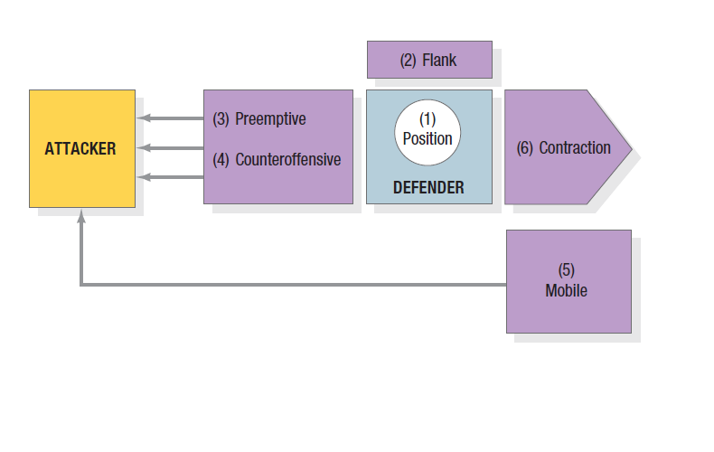
Figure 11.2 Types of Defense Strategies
Notes:
A dominant firm can use the six defense strategies summarized in Figure 11.2. Position defense means occupying the most desirable market space in consumers’ minds, making the brand almost impregnable.
With a flank defense, the market leader should erect outposts to protect a weak front or support a possible counterattack.
With a preemptive defense, a more aggressive maneuver is to attack first, perhaps with guerrilla action across the market—hitting one competitor here, another there—and keeping everyone off balance.
Another is to achieve broad market envelopment that signals competitors not to attack. In a counteroffensive, the market leader can meet the attacker frontally and hit its flank, or launch a pincer movement so it will have to pull back to defend itself.
In mobile defense, the leader stretches its domain over new territories through market broadening and market diversification. Market broadening shifts the company’s focus from the current product to the underlying generic need. Market diversification shifts the company’s focus into unrelated industries. Sometimes large companies can no longer defend all their territory.
In planned contraction (also called strategic withdrawal), they give up weaker markets and reassign resources to stronger ones.

Slide 8
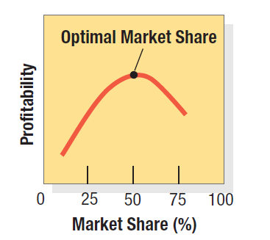
Figure 11.3 The Concept of Optimal Market Share
Notes:
Because the cost of buying higher market share through acquisition may far exceed its revenue value, a company should consider four factors.
The possibility of provoking antitrust action.
Economic cost. Figure 11.3 shows that profitability might fall with market share gains after some level. In the illustration, the firm’s optimal market share is 50 percent. The cost of gaining further market share might exceed the value if holdout customers dislike the company, are loyal to competitors, have unique needs, or prefer dealing with smaller firms.
The danger of pursuing the wrong marketing activities. Companies successfully gaining share typically outperform competitors in three areas: new-product activity, relative product quality, and marketing expenditures.
The effect of increased market share on actual and perceived quality. Too many customers can put a strain on the firm’s resources, hurting product value and service delivery.

Slide 9
General Attack Strategies
Frontal attack
Flank attack
Encirclement attack
Bypass attack
Guerilla warfare
Notes:
Given clear opponents and objectives, what attack options are available? We can distinguish five: frontal, flank, encirclement, bypass, and guerilla attacks. In a pure frontal attack, the attacker matches its opponent’s product, advertising, price, and distribution. A flanking strategy is another name for identifying shifts that are causing gaps to develop, then rushing to fill the gaps. Encirclement attempts to capture a wide slice of territory by launching a grand offensive on several fronts. Bypassing the enemy altogether to attack easier markets instead offers three lines of approach: diversifying into unrelated products, diversifying into new geographical markets, and leapfrogging into new technologies. Guerrilla attacks consist of small, intermittent attacks, conventional and unconventional, including selective price cuts, intense promotional blitzes, and occasional legal action, to harass the opponent and eventually secure permanent footholds.

Slide 10
Specific Attack Strategies
Price discounts
Lower-priced goods
Value-priced goods
Prestige goods
Product proliferation
Product innovation
Improved services
Distribution innovation
Manufacturing-cost reduction
Intensive advertising promotion
Notes:
Any aspect of the marketing program can serve as the basis for attack, such as lower-priced or discounted products, new or improved products and services, a wider variety of offerings, and innovative distribution strategies. A challenger’s success depends on combining several, more specific, strategies to improve its position over time.

Slide 11
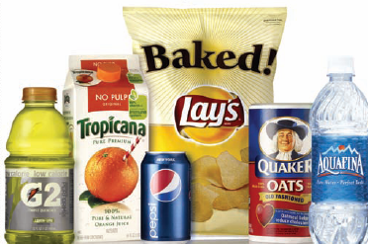
Market Follower Strategies
Notes:
Followers must know how to hold current customers and win a fair share of new ones. Each follower tries to bring distinctive advantages to its target market—location, services, financing–while defensively keeping its manufacturing costs low and its product quality and services high. It must also enter new markets as they open up. The follower must define a growth path, but one that doesn’t invite competitive retaliation. We distinguish four broad strategies:
1. The counterfeiter duplicates the leader’s product and packages and sells it on the black market or through disreputable dealers.
2. The cloner emulates the leader’s products, name, and packaging, with slight variations.
3. The imitator copies some things from the leader but differentiates on packaging, advertising, pricing, or location.
4. The adapter takes the leader’s products and adapts or improves them.

Slide 12
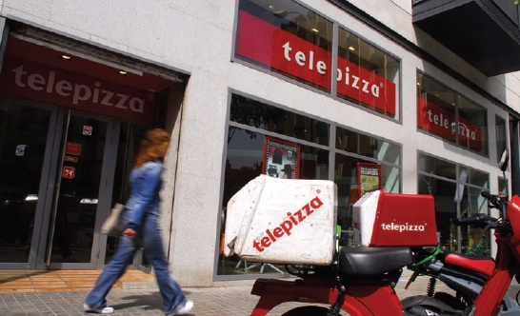
Market Nicher Strategies
Notes:
An alternative to being a follower in a large market is to be a leader in a small market, or niche. Smaller firms normally avoid competing with larger firms by targeting small markets of little or no interest to the larger firms. But even large, profitable firms may choose to use niching strategies for some of their business units or companies.

Slide 13
Niche Specialist Roles
End-User Specialist
Vertical-Level Specialist
Customer-Size Specialist
Specific-Customer Specialist
Geographic Specialist
Product-Line Specialist
Job-Shop Specialist
Quality-Price Specialist
Service-Specialist
Channel Specialist
Notes:
This slide lists the many roles of niche specialists.
End-user specialists specialize in one type of end-use customer.
• Vertical-level specialists specialize at some vertical level of the production-distribution value chain.
• Customer-size specialists concentrate on either small, medium-sized, or large customers.
• Specific-customer specialists limit its selling to one or a few customers.
• Geographic specialists sell only in a certain locality, region, or area of the world.
• Product or product-line specialists carry or produce only one product line or product.
• Product-feature specialists specialize in producing a certain type of product or product feature.
• Job-shop specialists customize its products for individual customers.
• Quality-price specialists operate at the low- or high quality ends of the market.
• Service specialists offer one or more services not available from other firms.
• Channel specialists specialize in serving only one channel of distribution.

Slide 14
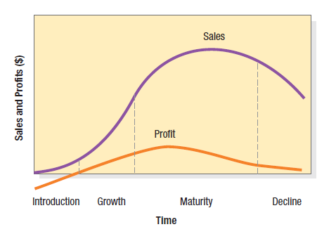
Figure 11.4 Sales and Profit Life Cycles
Notes:
Most product life-cycle curves are portrayed as bell-shaped as shown in Figure 11.4. This curve is typically divided into four stages: introduction, growth, maturity, and decline.
In the Introduction stage, there is a period of slow sales growth as the product is introduced in the market. Profits are nonexistent because of the heavy expenses of product introduction.
In the Growth stage, there is a period of rapid market acceptance and substantial profit improvement.
In the Maturity stage, there is a slowdown in sales growth because the product has achieved acceptance by most potential buyers. Profits stabilize or decline because of increased competition.
In Decline, sales show a downward drift and profits erode.

Slide 15
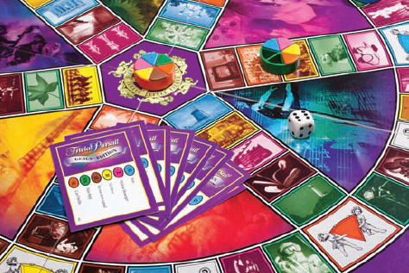
Maintaining a Market Advantage: Trivial Pursuit
Notes:
Parker Brothers has kept it popular by making a new game with updated questions every year. It also keeps creating offshoots—travel packs, a children’s version, Trivial Pursuit Genus IV, and themed versions tapping into niches tied to various sports, movies, and decades— 23 different versions in all. The game is available in a variety of platforms: as an interactive CD-ROM from Virgin Entertainment Interactive; online at its own Web site (www.trivialpursuit.com), and in a mobile edition accessible via cell phone.

Slide 16
Growth Stage Strategies
To sustain rapid market share growth now, firms can pursue several strategies including
improve product quality and adds new features and improved styling;
add new models and flanker products (of different sizes, flavors, and so forth) to protect the main product;
enter new market segments;
increase its distribution coverage and enters new distribution channels;
shift from awareness and trial communications to preference and loyalty communications; and
lower prices to attract the next layer of price-sensitive buyers.
The Smartphone market is currently in the growth stage.
Notes:
To sustain rapid market share growth now, firms can pursue several strategies including
• improve product quality and adds new features and improved styling;
• add new models and flanker products (of different sizes, flavors, and so forth) to protect the main product;
• enter new market segments;
• increase its distribution coverage and enters new distribution channels;
• shift from awareness and trial communications to preference and loyalty communications; and
• lower prices to attract the next layer of price-sensitive buyers.
The Smartphone market is currently in the growth stage.

Slide 17
Decline
Declining sales
Low cost per customer
Declining profits
Laggards
Notes:
Sales decline for a number of reasons, including technological advances, shifts in consumer tastes, and increased domestic and foreign competition. All can lead to overcapacity, increased price cutting, and profit erosion. The decline might be slow, as for sewing machines and newspapers, or rapid, as for 5.25 floppy disks and eight-track cartridges. The first task is to establish a system for identifying them. Many companies appoint a product-review committee with representatives from marketing, R&D, manufacturing, and finance who, based on all available information, makes a recommendation for each product—leave it alone, modify its marketing strategy, or drop it. Some firms abandon declining markets earlier than others. Harvesting calls for gradually reducing a product or business’s costs while trying to maintain sales. When a company decides to divest a product with strong distribution and residual goodwill, it can probably sell the product to another firm. If the firm cannot find buyers, it must decide on liquidation.

Slide 18
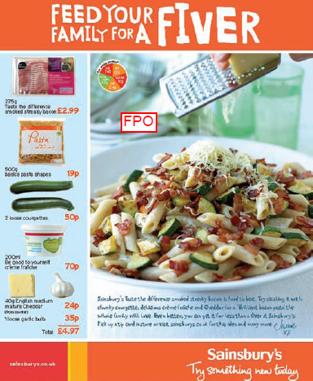
Marketing in an Economic Downturn
Invest
Get close to customers
Review budgets
Use a compelling value proposition
Fine-tune offerings
Notes:
Despite reduced funding for marketing programs and intense pressure to justify them as cost effective, some marketers survived—or even thrived—in the recession. This slide lists five guidelines to improve the odds for success during an economic downturn.

Slide 19
16 Managing Retailing, Wholesaling, and Logistics

Slide 20
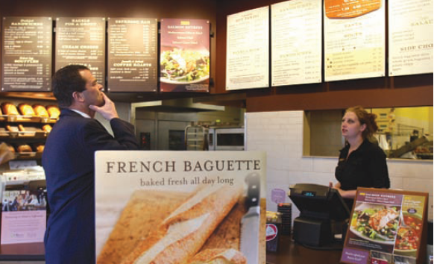
Retailing
Notes:
Retailing includes all the activities in selling goods or services directly to final consumers for personal, non-business use. A retailer or retail store is any business enterprise whose sales volume comes primarily from retailing.
Any organization selling to final consumers—whether it is a manufacturer, wholesaler, or retailer—is doing retailing. It doesn’t matter how the goods or services are sold (in person, by mail, telephone, vending machine, or on the Internet) or where (in a store, on the street, or in the consumer’s home).

Slide 21
Major Retailer Types
Specialty store
Department store
Supermarket
Convenience store
Discount store
Off-price retailer
Superstore
Catalog showroom
Notes:
This slide lists the major types of retailers.
Specialty stores carry a narrow product line. Department stores carry several product lines. Supermarkets are large, low-cost, low-margin, high-volume, self-service store designed to meet total needs for food and household products. Convenience stores are small stores in residential area, often open 24/7, limited line of high-turnover convenience products plus takeout. Drug stores carry prescription and pharmacies, health and beauty aids, other personal care, small durable, miscellaneous items. Discount stores are standard or specialty merchandise; low-price, low-margin, high-volume stores. Extreme value or hard-discount store carry a more restricted merchandise mix than discount stores but at even lower prices. Off-price retailers carry leftover goods, overruns, irregular merchandise sold at less than retail. Superstores are huge selling spaces, routinely purchased food and household items, plus services. Category killers carry a deep assortment in one category. Hypermarkets are huge stores that combine supermarket, discount, and warehouse retailing. Catalog showrooms include a broad selection of high-markup, fast-moving, brand-name goods sold by catalog at a discount.

Slide 22
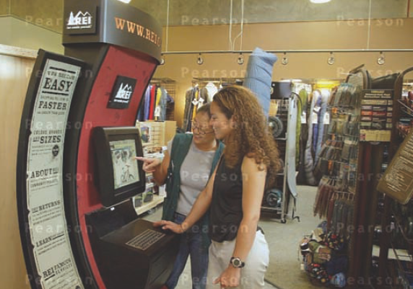
Nonstore Retailing
Direct selling
Direct marketing
Automatic vending
Buying service
Notes:
Although the overwhelming bulk of goods and services— 97 percent—is sold through stores, nonstore retailing has been growing much faster than store retailing. Nonstore retailing falls into four major categories:
1. Direct selling, also called multilevel selling and network marketing, is a multibillion-dollar industry, with hundreds of companies selling door-to-door or at home sales parties.
2. Direct marketing has roots in direct-mail and catalog marketing (Lands’ End, L.L.Bean). It includes telemarketing (1-800-FLOWERS), television direct-response marketing (HSN, QVC), and electronic shopping (Amazon.com, Autobytel.com).
3. Automatic vending offers a variety of merchandise, including impulse goods such as cigarettes, soft drinks, and more.
4. Buying service is a storeless retailer serving a specific clientele—usually employees of large organizations—who are entitled to buy from a list of retailers that have agreed to give discounts in return for membership.

Slide 23
Retailers’ Marketing Decisions
Target market
Product assortment
Procurement
Prices
Services
Store atmosphere
Store activities
Store experiences
Communications
Location
Notes:
With this new retail environment as a backdrop, we will examine retailers’ marketing decisions in the areas of target market, channels, product assortment, procurement, prices, services and store atmosphere, store activities and experiences, communications, and location.

Slide 24
Tips for Increasing Sales in Retail Space
Keep shoppers in the store
Honor the transition zone
Don’t make them hunt
Make merchandise available to the reach and touch
Note that men do not ask questions
Remember women need space
Make checkout easy
Notes:
This slide shares guidelines for retailers from the Marketing Memo.

Slide 25
Private Label Brands
Private labels are ubiquitous
Consumer accepts private labels
Private-label buyers come from all socioeconomic strata
Private labels are not a recessionary phenomenon
Consumer loyalty shifts from manufacturers to retailers
Notes:
A private label brand (also called a reseller, store, house, or distributor brand) is a brand that retailers and wholesalers develop. Benetton, The Body Shop, and Marks & Spencer carry mostly own-brand merchandise.
For many manufacturers, retailers are both collaborators and competitors. According to the Private Label Manufacturers’ Association, store brands now account for one of every four items sold in U.S. supermarkets, drug chains, and mass merchandisers.

Slide 26
Supply Chain Management
Supply chain management starts before physical distribution and means strategically procuring the right inputs (raw materials, components, and capital equipment); converting them efficiently into finished products; and dispatching them to the final destinations.
Notes:
Physical distribution starts at the factory. Managers choose a set of warehouses (stocking points) and transportation carriers that will deliver the goods to final destinations in the desired time or at the lowest total cost. Physical distribution has now been expanded into the broader concept of supply chain management (SCM). Supply chain management starts before physical distribution and means strategically procuring the right inputs (raw materials, components, and capital equipment); converting them efficiently into finished products; and dispatching them to the final destinations.

Slide 27
Market Logistics
Sales forecasting
Distribution scheduling
Production plans
Finished-goods inventory decisions
Packaging
In-plant warehousing
Shipping-room processing
Outbound transportation
Field warehousing
Customer delivery and servicing
Notes:
Market logistics encompass several activities. The first is sales forecasting, on the basis of which the company schedules distribution, production, and inventory levels. Production plans indicate the materials the purchasing department must order. These materials arrive through inbound transportation, enter the receiving area, and are stored in raw-material inventory. Raw materials are converted into finished goods. Finished-goods inventory is the link between customer orders and manufacturing activity. Customers’ orders draw down the finished-goods inventory level, and manufacturing activity builds it up. Finished goods flow off the assembly line and pass through packaging, in-plant warehousing, shipping-room processing, outbound transportation, field warehousing, and customer delivery and servicing.

Slide 28
17 Designing and Integrating Marketing Communications

Slide 29
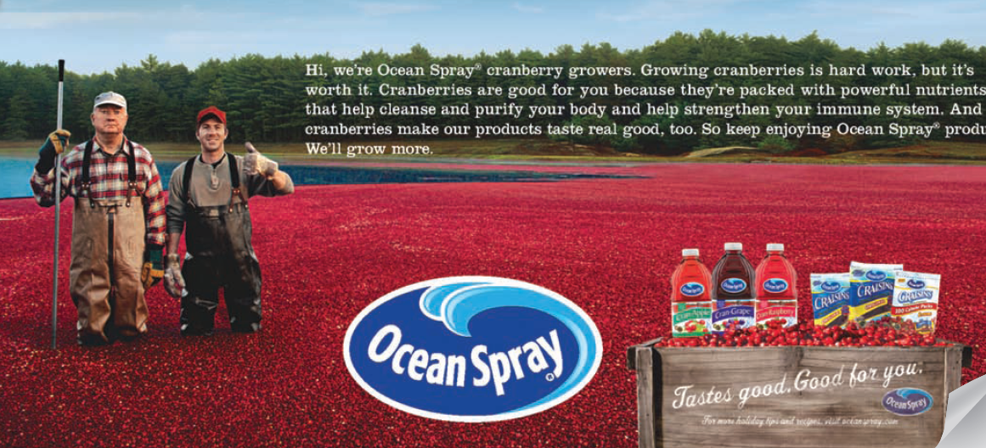
Marketing Communications
Notes:
Marketing communications are the means by which firms attempt to inform, persuade, and remind consumers—directly or indirectly—about the products and brands they sell. In a sense, marketing communications represent the voice of the company and its brands; they are a means by which the firm can establish a dialogue and build relationships with consumers. Ocean Spray—an agricultural cooperative of cranberry growers—has used a variety of communication vehicles to turn its sales fortunes around.
Facing stiff competition, a number of adverse consumer trends, and nearly a decade of declining sales, Ocean Spray COO Ken Romanzi and Arnold Worldwide decided to “reintroduce the cranberry to America” as the “surprisingly versatile little fruit that supplies modern-day benefits,” through a true 360-degree campaign that used all facets of marketing communications to reach consumers in a variety of settings. The intent was to support the full range of products—cranberry sauce, fruit juices, and dried cranberries in different forms—and leverage the fact that the brand was born in the cranberry bogs and remained there still.

Slide 30
Modes of Marketing Communications
Advertising
Sales promotion
Events and experiences
Public relations and publicity
Direct marketing
Interactive marketing
Word-of-mouth marketing
Personal selling
Notes:
The marketing communications mix consists of eight major modes of communication.
1. Advertising is any paid form of nonpersonal presentation and promotion of ideas, goods, or services by an identified sponsor.
2. Sales promotion is any variety of short-term incentives to encourage trial or purchase of a product or service.
3. Events and experiences are company-sponsored activities and programs designed to create daily or special brand-related interactions with consumers.
4. Public relations and publicity are a variety of programs directed internally to employees of the company or externally to consumers, other firms, the government, and media
5. Direct marketing is the use of mail, telephone, fax, e-mail, or Internet to communicate directly with or solicit response or dialogue from specific customers and prospects.
6. Interactive marketing is online activities and programs designed to engage customers or prospects.
7. Word-of-mouth marketing refers to people-to-people oral, written, or electronic communications.
8. Personal selling is face-to-face interaction with one or more prospective purchasers for the purpose of making presentations, answering questions, and procuring orders.

Slide 31
Communication Platforms
Advertising
Print and broadcast ads
Packaging inserts
Motion pictures
Brochures and booklets
Posters
Billboards
POP displays
Logos
Videotapes
Sales Promotion
Contests, games, sweepstakes
Premiums
Sampling
Trade shows, exhibits
Coupons
Rebates
Entertainment
Continuity programs
Notes:
Table 17.1 lists numerous communication platforms.

Slide 32
Communication Platforms
Events/ Experiences
Sports
Entertainment
Festivals
Art
Causes
Factory tours
Company museums
Street activities
Public Relations
Press kits
Speeches
Seminars
Annual reports
Charitable donations
Publications
Community relations
Lobbying
Identity media
Notes:
Table 17.1 lists numerous communication platforms.

Slide 33
Communication Platforms
Personal Selling
Sales presentations
Sales meetings
Incentive programs
Samples
Fairs and trade shows
Direct Marketing
Catalogs
Mailings
Telemarketing
Electronic shopping
TV shopping
Fax mail
E-mail
Voice mail
Websites
Notes:
Table 17.1 lists numerous communication platforms.

Slide 34
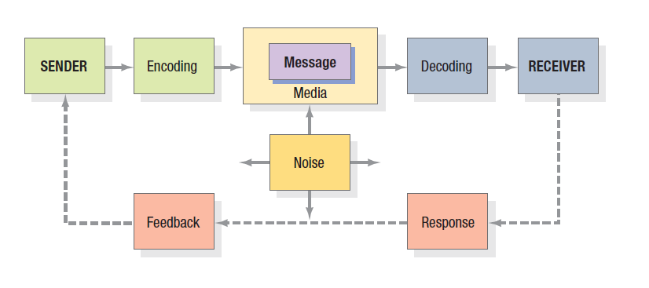
Figure 17.1 Elements in the Communications Process
Notes:
Marketers should understand the fundamental elements of effective communications. Two models are useful: a macromodel and a micromodel. Figure 17.1 shows a macromodel with nine key factors in effective communication. Two represent the major parties— sender and receiver. Two represent the major tools—message and media. Four represent major communication functions—encoding, decoding, response, and feedback. The last element in the system is noise, random and competing messages that may interfere with the intended communication.
Senders must know what audiences they want to reach and what responses they want to get. They must encode their messages so the target audience can decode them. They must transmit the message through media that reach the target audience and develop feedback channels to monitor the responses. The more the sender’s field of experience overlaps that of the receiver, the more effective the message is likely to be.

Slide 35
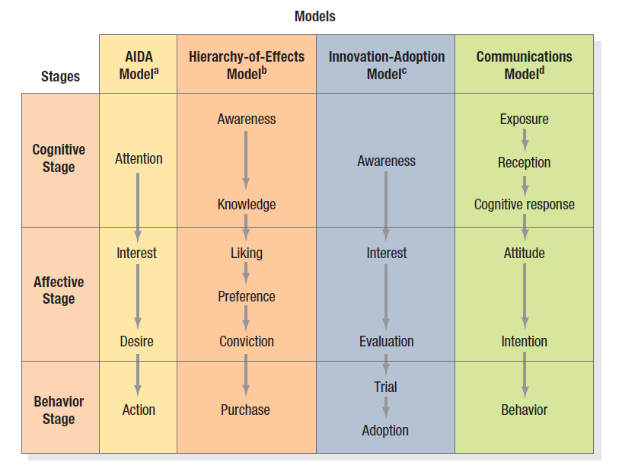
Figure 17.2 Micromodels of Communications
Notes:
Micromodels of marketing communications concentrate on consumers’ specific responses to communications. Figure 17.2 summarizes four classic response hierarchy models. All these models assume the buyer passes through cognitive, affective, and behavioral stages, in that order. This “learn-feel-do” sequence is appropriate when the audience has high involvement with a product category perceived to have high differentiation, such as an automobile or house. An alternative sequence, “do-feel-learn,” is relevant when the audience has high involvement but perceives little or no differentiation within the product category, such as an airline ticket or personal computer. A third sequence, “learn-do-feel,” is relevant when the audience has low involvement and perceives little differentiation, such as with salt or batteries. By choosing the right sequence, the marketer can do a better job of planning communications.

Slide 36
An Ideal Ad Campaign
The right consumer is exposed to the message at the right time and place
The ad causes consumer to pay attention
The ad reflects consumer’s level of understanding and behaviors with product
The ad correctly positions brand in terms of points-of-difference and points-of-parity
The ad motivates consumer to consider purchase of the brand
The ad creates strong brand associations
Notes:
To increase the odds for a successful marketing communications campaign, marketers must attempt to increase the likelihood that each step occurs. For example, the ideal ad campaign would ensure that:
1. The right consumer is exposed to the right message at the right place and at the right time.
2. The ad causes the consumer to pay attention but does not distract from the intended message.
3. The ad properly reflects the consumer’s level of understanding of and behaviors with the product and the brand.
4. The ad correctly positions the brand in terms of desirable and deliverable points-of-difference and points-of-parity.
5. The ad motivates consumers to consider purchase of the brand, and
6. The ad creates strong brand associations with all these stored communications effects so they can have an impact when consumers are considering making a purchase.

Slide 37
Steps in Developing Effective Communications
Identify target audience
Determine objectives
Design communications
Select channels
Establish budget
Decide on media mix
Measure results/manage IMC
Notes:
Figure 17.3 shows the eight steps in developing effective communications. We begin with the basics: identifying the target audience, determining the objectives, designing the communications, selecting the channels, and establishing the budget.

Slide 38
Communications Objectives
Category need
Brand awareness
Brand attitude
Purchase intention
Notes:
There are four key communications objectives identified in this slide. We may try to establish a category need which means establishing a product or service category as necessary to remove or satisfy a perceived discrepancy between a current motivational state and a desired emotional state.
We may try to build brand awareness such that the consumer’s ability to recognize or recall the brand within the category, in sufficient detail to make a purchase. We may focus on brand attitude to help consumers evaluate the brand’s perceived ability to meet a currently relevant need. We may focus on brand purchase intention to move consumers to decide to purchase the brand or take purchase-related action.

Slide 39
Designing the Communications
Message strategy
Creative strategy
Message source
Notes:
Formulating the communications to achieve the desired response requires solving three problems: what to say (message strategy), how to say it (creative strategy), and who should say it (message source).The vision of GE’s Smart Grid program is to fundamentally overhaul the United States’ power grid, making it more efficient and sustainable and able also to deliver renewable-source energy such as wind and solar. An integrated campaign of print, TV, and online ads and an online augmented-reality demo was designed to increase understanding and support of the Smart Grid and GE’s leadership in solving technological problems. In its 2009 Super Bowl launch TV spot, the famous scarecrow character from The Wizard of Oz was shown bouncing along the top of a transmission tower singing, “If I Only Had a Brain.” A narrator voiced over the key communication message, “Smart Grid makes the way we distribute electricity more efficient simply by making it more intelligent.” One online ad used a flock of birds on electrical wires chirping and flapping their wings in synchronized rhythm to Rossini’s “Barber of Seville.” Another showed power lines becoming banjo strings for electrical pylons to play “O Susannah.” After drawing the audience in, the ads lay out the basic intent of the Smart Grid with links to more information. The augmented-reality GE microsite PlugIntoTheSmartGrid.com allowed users to create a digital hologram of Smart Grid technology using computer peripherals and 3D graphics.

Slide 40
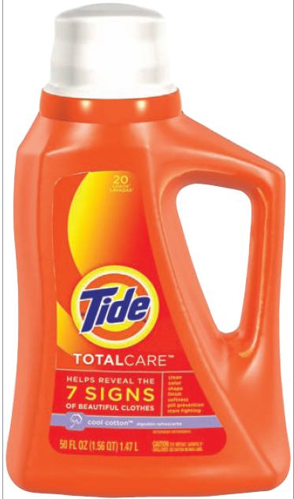
Message Strategy
Notes:
In determining message strategy, management searches for appeals, themes, or ideas that will tie in to the brand positioning and help establish points-of-parity or points-of-difference. Some of these may be related directly to product or service performance (the quality, economy, or value of the brand), whereas others may relate to more extrinsic considerations (the brand as being contemporary, popular, or traditional). Buyers are thought to expect four types of reward from a product: rational, sensory, social, or ego satisfaction. Buyers might visualize these rewards from results -of -use experience, product-in-use experience, or incidental-to-use experience. Crossing the four types of rewards with the three types of experience generates 12 types of messages. For example, the appeal “gets clothes cleaner” is a rational-reward promise following results-of-use experience. The phrase “real beer taste in a great light beer” is a sensory-reward promise connected with product-in-use experience.

Slide 41
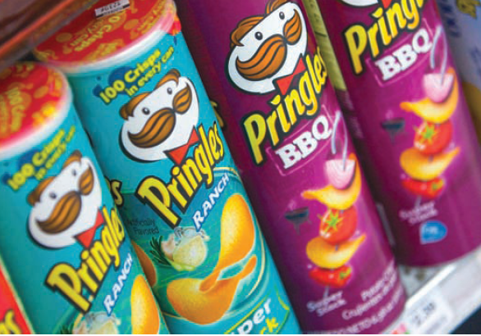
Creative Strategy
Informational and transformational appeals
Notes:
Communications effectiveness depends on how a message is being expressed, as well as on its content. If a communication is ineffective, it may mean the wrong message was used, or the right one was poorly expressed. Creative strategies are the way marketers translate their messages into a specific communication. We can broadly classify them as either informational or transformational appeals. An informational appeal elaborates on product or service attributes or benefits. Examples in advertising are problem solution ads (Excedrin stops the toughest headache pain), product demonstration ads (Thompson Water Seal can withstand intense rain, snow, and heat), product comparison ads (DIRECTV offers better HD options than cable or other satellite operators), and testimonials from unknown or celebrity endorsers (NBA phenomenon LeBron James pitching Nike, Sprite, and McDonald’s). Informational appeals assume strictly rational processing of the communication on the consumer’s part. A transformational appeal elaborates on a nonproduct-related benefit or image. It might depict what kind of person uses a brand (VW advertised to active, youthful people with its famed “Drivers Wanted” campaign) or what kind of experience results from use (Pringles advertised “Once You Pop, the Fun Don’t Stop” for years). Transformational appeals often attempt to stir up emotions that will motivate purchase.

Slide 42
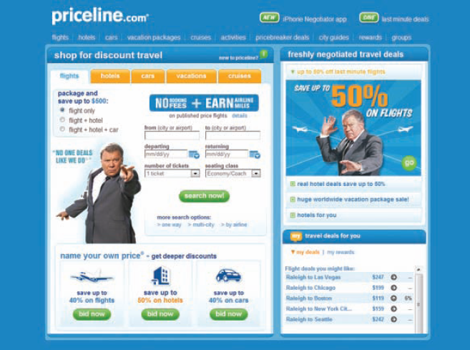
Message Source
Notes:
Messages delivered by attractive or popular sources can achieve higher attention and recall, which is why advertisers often use celebrities as spokespeople. Celebrities are likely to be effective when they are credible or personify a key product attribute. William Shatner is the spokesperson for Priceline.com.
What is important is the spokesperson’s credibility. The three most often identified sources of credibility are expertise, trustworthiness, and likability. Expertise is the specialized knowledge the communicator possesses to back the claim. Trustworthiness describes how objective and honest the source is perceived to be. Friends are trusted more than strangers or salespeople, and people who are not paid to endorse a product are viewed as more trustworthy than people who are paid. Likability describes the source’s attractiveness. Qualities such as candor, humor, and naturalness make a source more likable. The most highly credible source would score high on all three dimensions expertise, trustworthiness, and likability.

Slide 43
Establish the Budget
Affordable
Percentage-of-sales
Competitive parity
Objective-and-task
Notes:
One of the most difficult marketing decisions is determining how much to spend on marketing communications. John Wanamaker, the department store magnate, once said, “I know that half of my advertising is wasted, but I don’t know which half.” There are four common methods for setting budgets: the affordable method, the percentage-of-sales method, the competitive- parity method, and the objective-and-task method.
Some companies set the communication budget at what they think the company can afford. The affordable method completely ignores the role of promotion as an investment and the immediate impact of promotion on sales volume. Some companies set communication expenditures at a specified percentage of current or anticipated sales or of the sales price. Some companies set their communication budget to achieve share-of-voice parity with competitors. The objective-and-task method calls upon marketers to develop communication budgets by defining specific objectives, determining the tasks that must be performed to achieve these objectives, and estimating the costs of performing them. The sum of these costs is the proposed communication budget.

Slide 44
Objective-and-Task Method
Establish the market share goal.
Determine the percentage that should be reached.
Determine the percentage of aware prospects that should be persuaded to try the brand.
Determine the number of advertising impressions per 1% trial rate.
Determine the number of gross rating points that would have to be purchased.
Determine the necessary advertising budget on the basis of the average cost of buying a GRP.
Notes:
Here’s an example of using the Objective and Task Method. Suppose Dr. Pepper Snapple Group wants to introduce a new natural energy drink, called Sunburst, for the casual athlete. Its objectives might be as follows:
The company estimates 50 million potential users and sets a target of attracting 8 percent of the market—that is, 4 million users.
The advertiser hopes to reach 80 percent (40 million prospects) with its advertising message.
The advertiser would be pleased if 25 percent of aware prospects (10 million) tried Sunburst. It estimates that 40 percent of all triers, or 4 million people, will become loyal users.
The advertiser estimates that 40 advertising impressions (exposures) for every 1 percent of the population will bring about a 25 percent trial rate.
A gross rating point is one exposure to 1 percent of the target population. Because the company wants to achieve 40 exposures to 80 percent of the population, it will want to buy 3,200 gross rating points.
To expose 1 percent of the target population to one impression costs an
average of $3,277. Therefore, 3,200 gross rating points will cost $10,486,400 (= $3,277 × 3,200) in the introductory year.

Slide 45
Characteristics of the Mix
Advertising
Pervasiveness
Amplified expressiveness
Impersonality
Sales Promotion
Communication
Incentive
Invitation
Notes:
This slide explains the characteristics of advertising and sales promotion. Advertising permits the seller to repeat a message many times. It also allows the buyer to receive and compare the messages of various competitors. Large-scale advertising says something positive about the seller’s size, power, and success. Advertising provides opportunities for dramatizing the company and its products through the artful use of print, sound, and color. The advertiser can choose the aspects of the brand and product on which to focus communications.
Companies use sales promotion tools—coupons, contests, premiums, and the like—to draw a stronger and quicker buyer response, including short-run effects such as highlighting product offers and boosting sagging sales. Sales promotion tools offer three distinctive benefits: They draw attention and may lead the product. They incorporate some concession, inducement, or contribution that gives value to the consumer. They include a distinct invitation to engage in the transaction now.

Slide 46
Characteristics of the Mix
Public Relations and Publicity
High credibility
Ability to catch buyers off guard
Dramatization
Events and Experiences
Relevant
Involving
Implicit
Notes:
This slide explains the characteristics of public relations and events. Marketers tend to underuse public relations, yet a well-thought-out program coordinated with the other communications-mix elements can be extremely effective, especially if a company needs to challenge consumers’ misconceptions. The appeal of public relations and publicity is based on three distinctive qualities: high credibility, ability to reach hard-to-find buyers, and dramatization.
There are many advantages to events and experiences as long as they have the following characteristics. The events should be relevant, engaging, and include a soft implicit sell rather than a direct one.

Slide 47
Characteristics of the Mix
Direct Marketing
Customized
Up-to-date
Interactive
Word of Mouth Marketing
Credible
Personal
Timely
Personal Selling
Personal interaction
Cultivation
Response
Notes:
This slide explains the characteristics of direct marketing, personal selling, and word of mouth marketing. Direct and interactive marketing messages share three characteristics. They can be customized, current, and interactive.
Word of mouth also takes many forms both online or offline. Three noteworthy characteristics are the level of influence, personalization, and timeliness.
Personal selling is the most effective tool at later stages of the buying process, particularly in building up buyer preference, conviction, and action. Personal selling has three notable qualities. It includes personal interactions. It enables relationship cultivation. The buyer is given personal choices and encouraged to respond.

Slide 48
Factors in Setting Communications Mix
Type of product market
Buyer readiness stage
Product life cycle stage
Notes:
Companies must consider several factors in developing their communications mix: type of product market, consumer readiness to make a purchase, and stage in the product life cycle.

Slide 49
Class wrap up
What is due for next week

